Slide 1

Using QLab with Eos
Jim Uphoff and Hans Hinrichsen

Slide 2
Let’s Play!

Slide 3
Game Elements
Score Keeping
IR Sensor
iPad
Gameplay Actions
Microphone – Sound2Light
Shotbox
Ambience
Pre/post music and lights
OSC triggered, MIDI Time Code synchronized

Slide 4
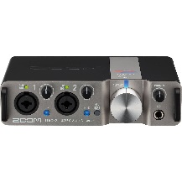
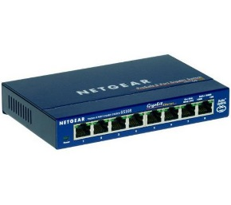
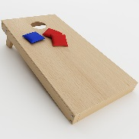


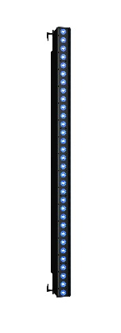
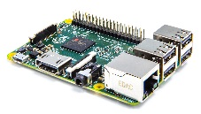

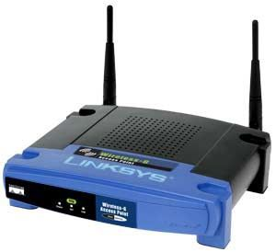
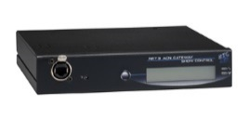
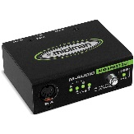

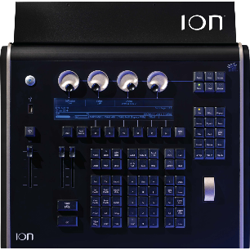
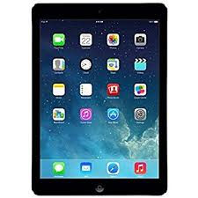
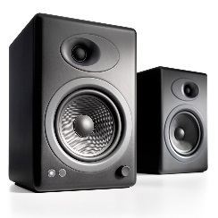
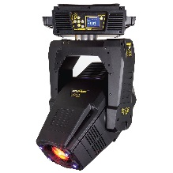
Riser
Audio
USB
OSC (Net)
IR Sensor
OSC (Net)
OSC (Net)
ACN (Net)
MIDI
USB
OSC (Net)
DMX
Audio
DMX
OSC
ACN, OSC (Net)
Notes:
Walk through riser, step by step building system

Slide 5
Protocols
MIDI – MIDI Time Code
OSC - Open Sound Control
IP Recap
Messages – Address Patterns and Arguments
UDP vs TCP
OSC v1.0 vs v1.1

Slide 6
MIDI Time Code
Representation of time over MIDI
hh:mm:ss:ff (Hours, Minutes, Seconds, Frames)
24, 25, 29.97, 30 frames
Used to synchronize devices
Carries no other “meaningful” information – is only a synchronization method
Internal vs external timecode
Freewheeling

Slide 7
OSC – Network Setup
Wired Network
Everything must be in a compatible subnet
ETC default: 10.101.x.x or 10.101.0.0/16

Slide 8
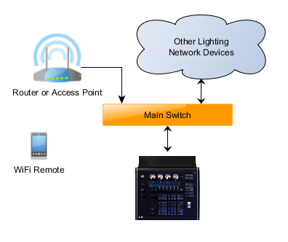
OSC – Wireless Setup
Wireless Network
Using a wireless router, connected to WAN port
Router WAN port – 10.101.125.1
Router LAN subnet – 192.168.1.0/24
Router provides DHCP server
Router filters data we don’t want on the wireless link
Router still passes OSC to console

Slide 9
OSC – UDP vs TCP
IP: UDP vs TCP
User Datagram Protocol
Stateless – no “connection”
Does not guarantee message reaches destination
Transmission Control Protocol
Direct connection
Guaranteed delivery
Two OSC versions – 1.0 (packet length) and 1.1 (SLIP)
Must match for two devices to talk to each other!
IP: Ports
An endpoint or “mailbox” associated with an IP address
10.101.2.177:53000

Slide 10
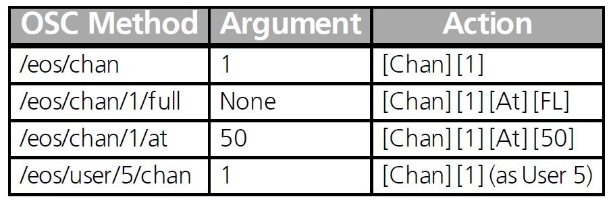
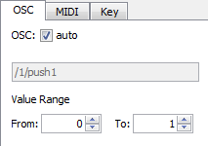
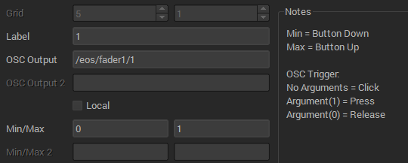

OSC Messages
Address Pattern and Arguments
Pattern – command
Arguments – information to supplement command
Arguments vary based on platform used to send them!
TouchOSC
Eos Magic Sheets
OSCWidgets

Slide 11
Message Examples
QLab
/cue/1/start
/cue/1/stop
Eos
/eos/cue/1/1/fire
/eos/macro/11/fire
/eos/user=1
/eos/sc/game_start (Event List!)

Slide 12
Elements
UDP OSC
Ion Console
TouchOSC on an iPad
Raspberry Pi (Raspbian) with Python code
MacBook Pro and QLab

Slide 13
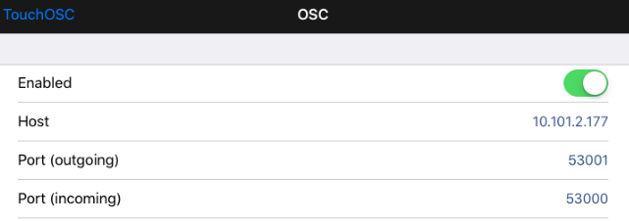
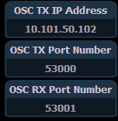
OSC: UDP
Setup - General
Specify send and receive ports
Remember that send on one device needs to match receive on the other
Specify transmit IP address (IP of device that is receiving the UDP OSC)

Slide 14
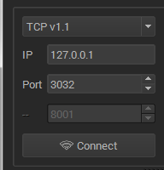
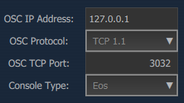

Elements
TCP OSC (1.1)
Ion Console
PC running Sound2Light
PC running OSCWidgets
QLab
Eos
TCP Port 3032
Configurable between v1.0 (packet length) and v1.1 OSC (SLIP)
QLab
TCP Port 53000
SLIP (v1.1) only
Eos and QLab cannot directly connect via TCP – both “servers”

Slide 15
Game Elements - Configuration
Score Keeping
IR Sensor
iPad
Gameplay Actions
Microphone – Sound2Light
Shotbox
Ambience
Pre/post music and lights
OSC triggered, MIDI Time Code synchronized

Slide 16
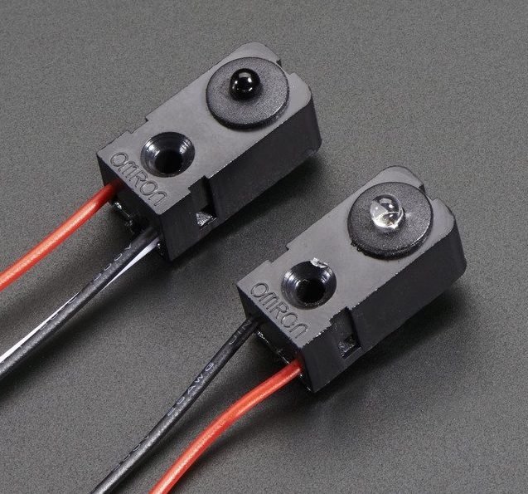
IR Sensor
Adafruit 2167 IR Sensor
https://www.adafruit.com/product/2167
Raspberry Pi
https://www.raspberrypi.org/downloads/raspbian/
Python3
Osc4py3 library
http://osc4py3.readthedocs.io

Slide 17
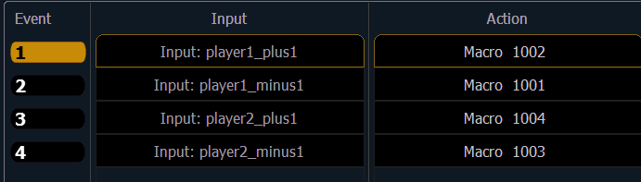
Eos: Show Control List Messages
Define an OSC input that describes action
Implementation can change without rewriting OSC device’s mapping
/eos/sc/player1_plus1
Runs Macro 1002
Press Go on Cue List 11

Slide 18
Showfiles and Code
Showfiles
https://github.com/hinrichsenhans/cue2017
PiBags
https://github.com/hinrichsenhans/pibags

Slide 19


